Slide 1
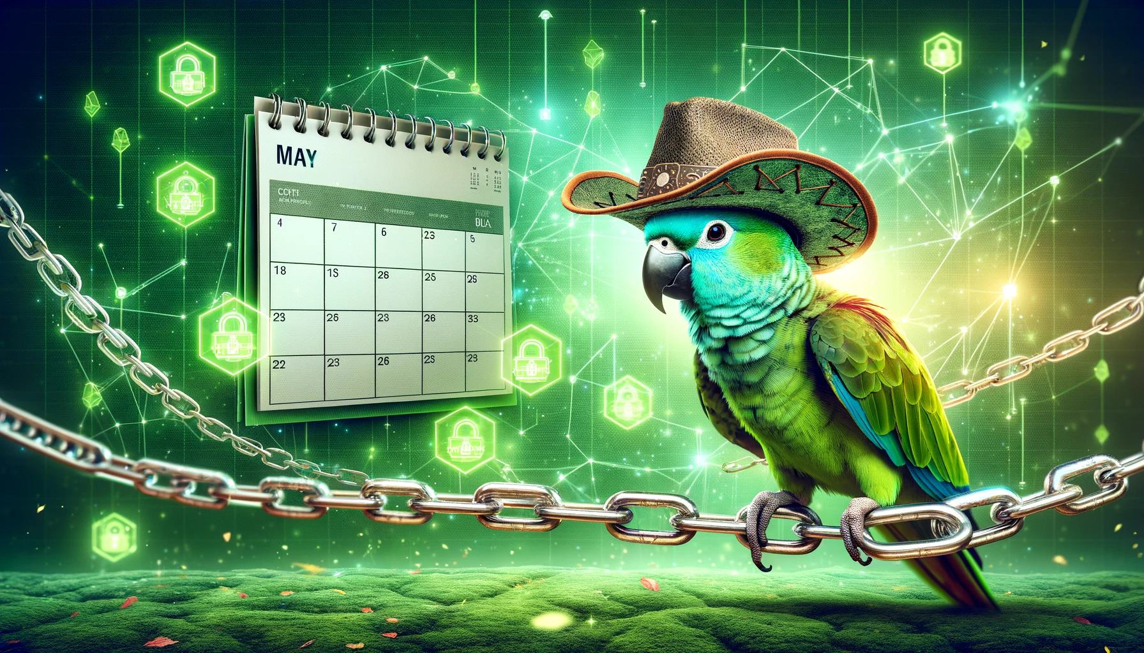
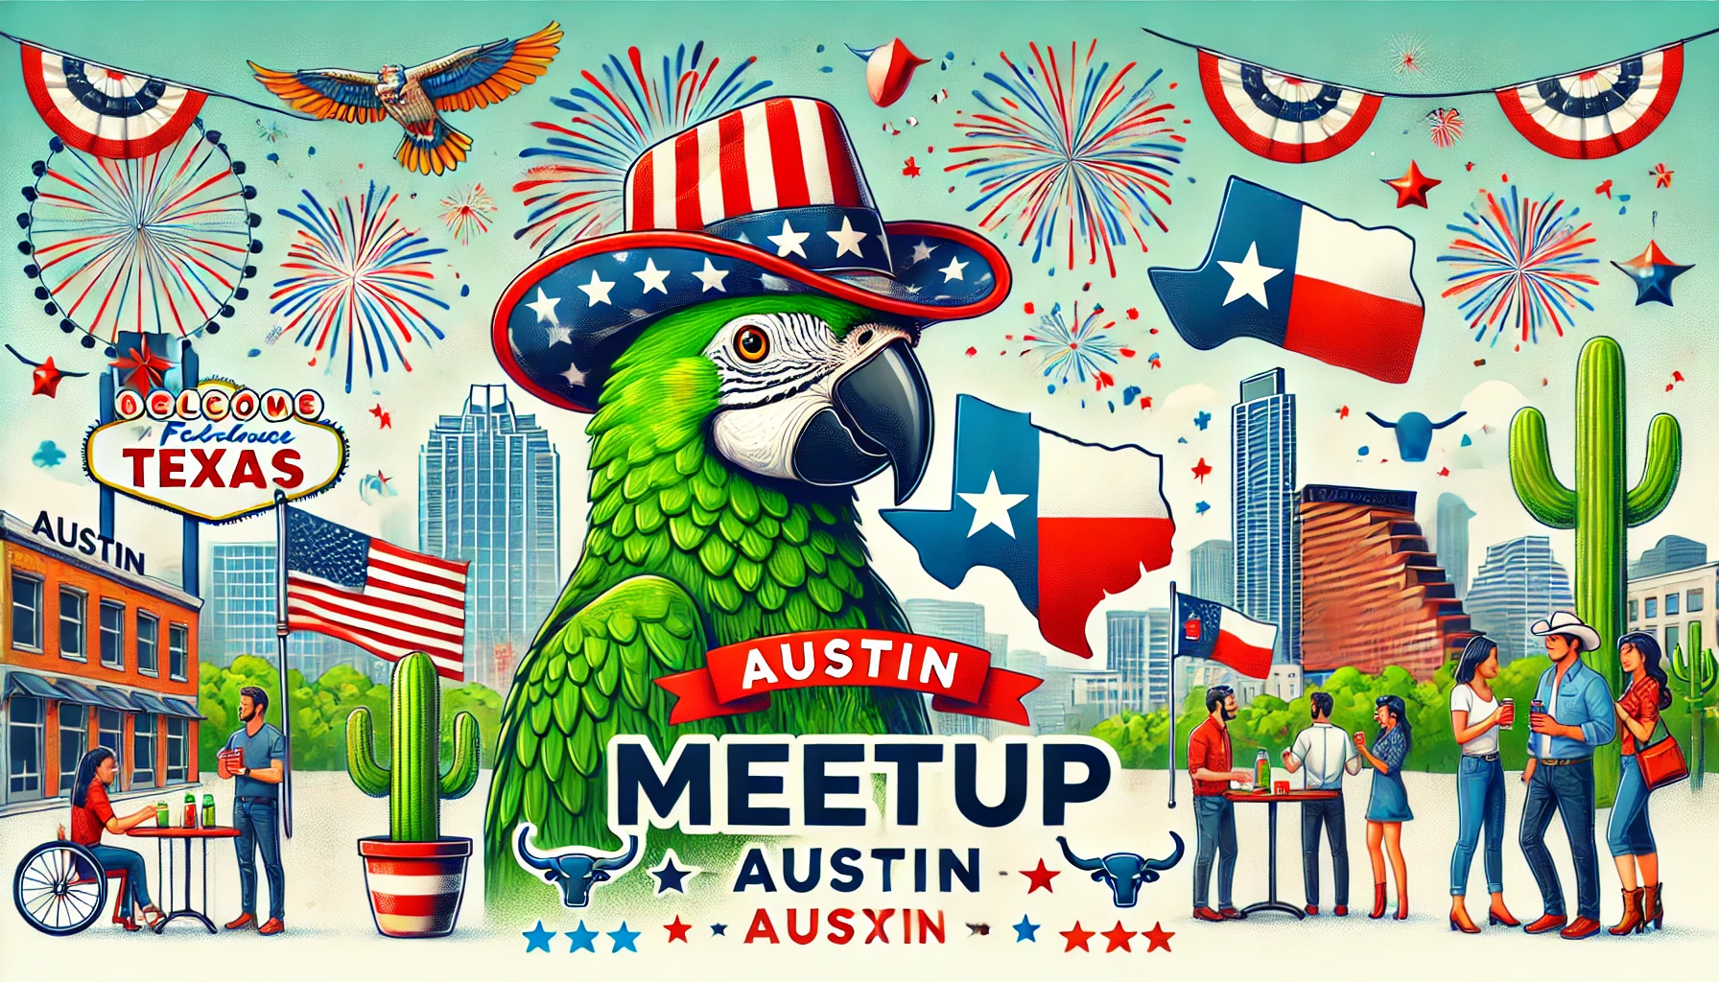
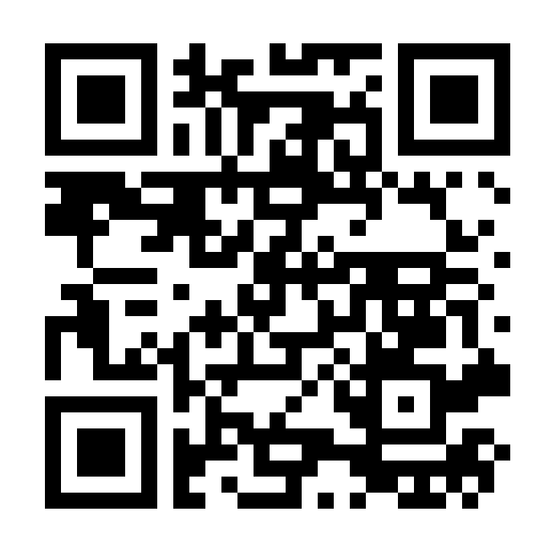
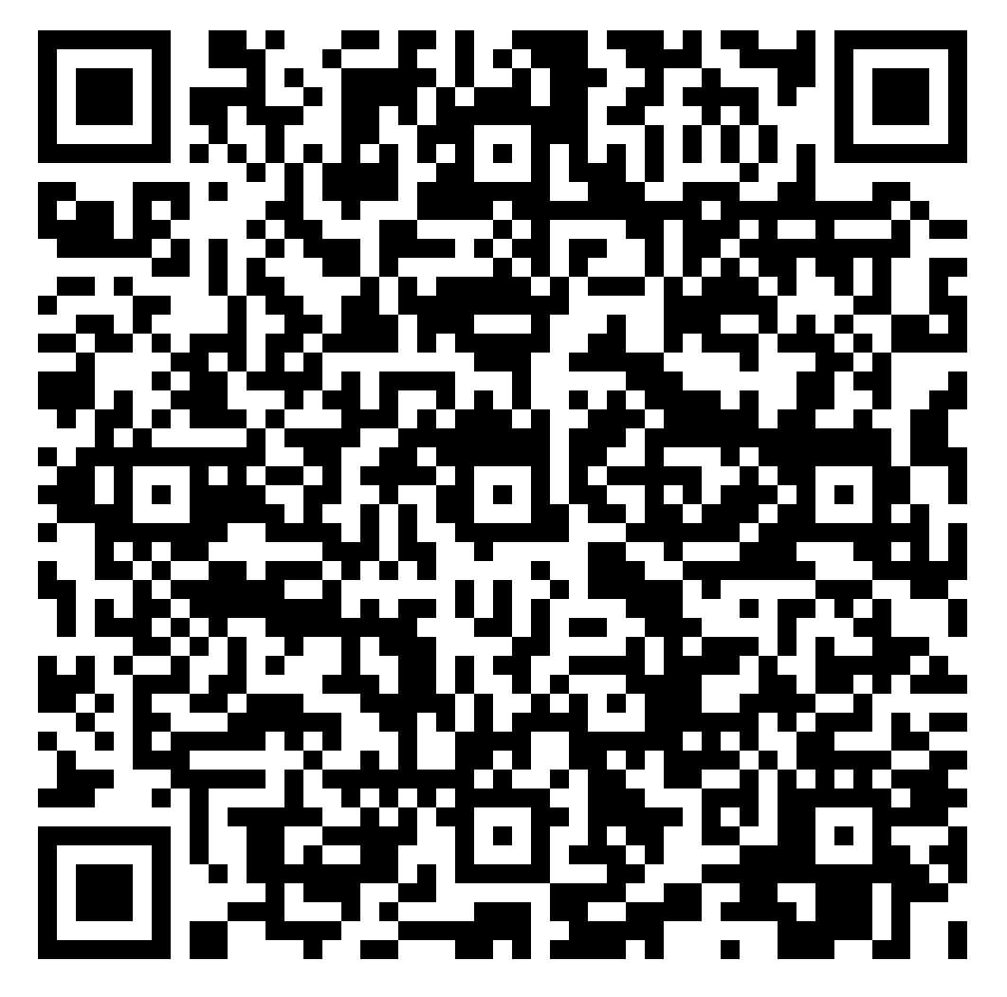
🦜🔗 May Meeting - AI Data Scientist, Lessons Learned Panel, Blockchain Agents
Austin LangChain Users Group
Austin LangChain Users Group
July Meeting - 7:15 CST Start
Github
meet.aimug.org

Slide 2
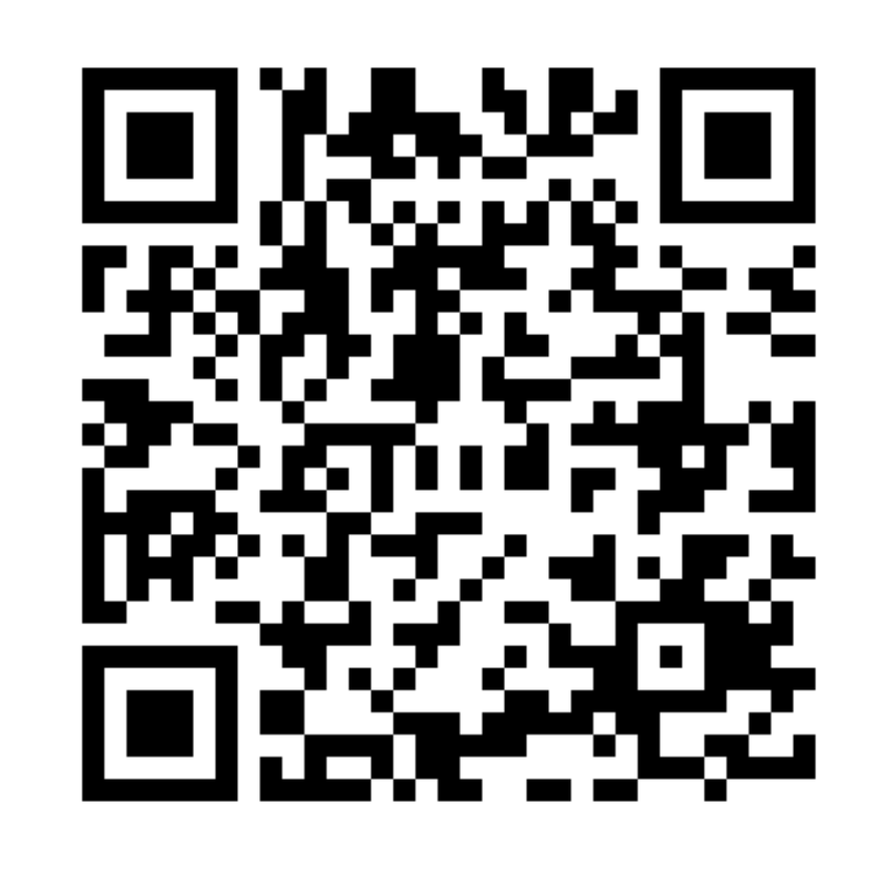
🦜🔗 July Meeting - Quickstart +
NVIDIA Contest Showcases
Austin LangChain Users Group
Github
meet.aimug.org

Slide 3
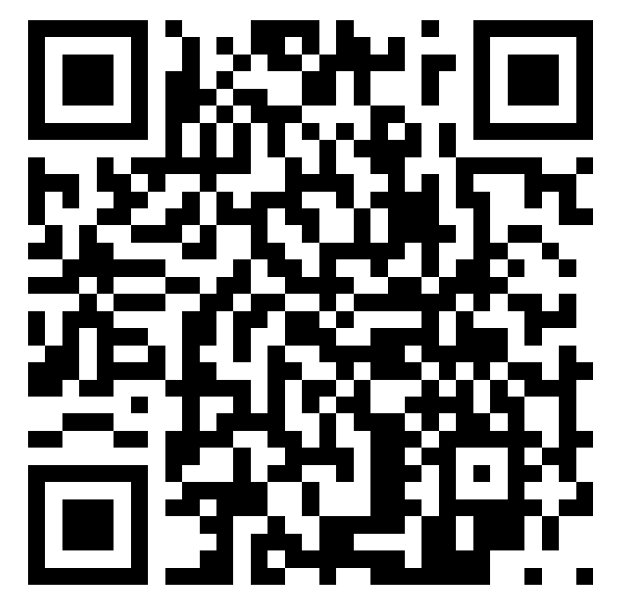
Welcome - Austin LangChain
Local Austin LangChain User Group
Discord - https://discord.gg/fjQfpwcsZX
Github - https://github.com/colinmcnamara/austin_langchain
Meetup - https://www.meetup.com/austin-lanchain-ai-group/
Twitter - @AustinLangChain
Youtube - https://www.youtube.com/@AustinLangChain
Monthly Showcases & Mixer
Monthly Hacky Hours
Office Hours 2PM CDT Office Hours
Low stress, learning and sharing
Connect with other early adopters
Learn, Share, Grow
CoC - Be cool to each other, no gross behavior
Notes:
Are you a AI / LLM enthusiast who finds the power of LangChain fascinating? Are you currently learning and utilizing this innovative technology? Look no further! Our meetup group is the perfect platform for you to connect with like-minded individuals in the Austin area who share your passion for LangChain.
Whether you're a beginner eager to dive into the world of LangChain or an experienced user looking to expand your knowledge, our group provides an inclusive and supportive environment for all levels of expertise. Join us to engage in enlightening discussions, share valuable insights, and collaborate on exciting projects related to LangChain.
Here's what you can expect from our meetup group:
Informative Presentations: We regularly host presentations by industry experts, researchers, and practitioners who will share their expertise and insights into the latest advancements in LangChain. These talks will cover various aspects, including best practices, practical applications, and future trends.
Hands-on Workshops: Get ready to roll up your sleeves and get your hands dirty! We organize interactive workshops that allow you to put your knowledge into practice. Learn how to leverage LangChain effectively through practical exercises, coding sessions, and collaborative problem-solving activities.
Networking Opportunities: Connect with fellow language enthusiasts, developers, researchers, and professionals who are passionate about LangChain. Expand your professional network, exchange ideas, and foster meaningful connections that can potentially lead to exciting collaborations or career opportunities.
Project Showcases: Share your LangChain projects and see what others have been working on. Our group provides a platform for members to showcase their creations, seek feedback, and receive support and encouragement from the community. This is a fantastic opportunity to gain inspiration, learn from others, and contribute to the growth of the LangChain ecosystem.
Q&A Sessions and Discussions: Have burning questions or specific topics you'd like to explore? Our meetups include interactive Q&A sessions and group discussions where you can seek clarifications, share your experiences, and engage in thought-provoking conversations about LangChain and its applications.
Join us today and become part of the vibrant Austin LangChain community! Let's learn, collaborate, and shape the future of language technology together. Whether you're a student, professional, researcher, or simply a curious individual, we welcome everyone with open arms. Together, we'll unlock the true potential of LangChain and revolutionize the way we interact with languages.
Note: This meetup group is conducted in English, and proficiency in LangChain is not a prerequisite for participation. We believe in creating an inclusive environment where everyone can learn and grow together.

Slide 4
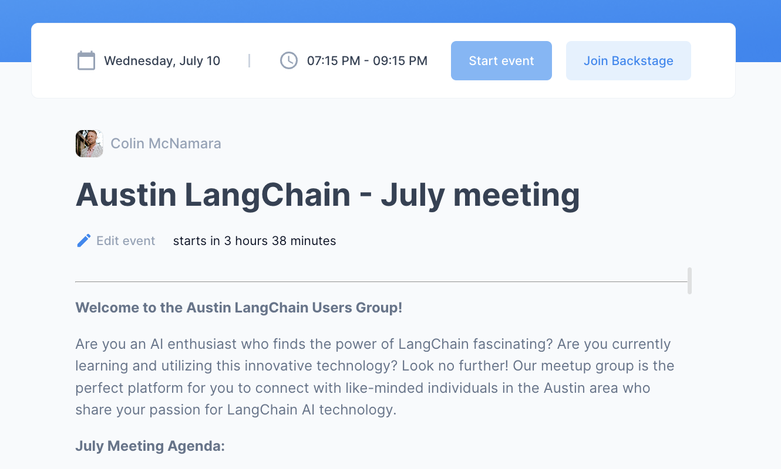
Log into Sessions @ meet.aimug.org
Go here for Transcripts, Q&A, Links
https://meet.aimug.org/session/6cacd549-11e1-42c2-a3bc-01def0906ac2

Slide 5

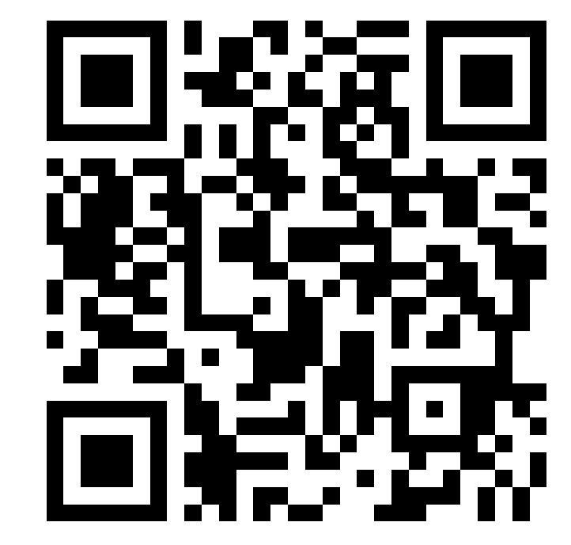
LangChain Overview
Colin McNamara
Home: Austin, East Side
Work: Managing Partner, Engineering & Finance @ Always Cool Brands
Background: Hyperscale Cloud Engineering & Operations
FOSS: Linux, OpenStack, OpenDaylight, …
Using LangChain: Business operations
Socials:
WWW http://www.colinmcnamara.com
Linkedin https://www.linkedin.com/in/colinmcnamara/
X(Twitter) @colinmcnamara

Slide 6
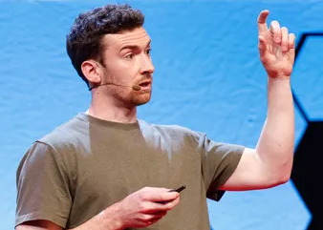
LangChain (Upstream) Project
Blog - https://blog.langchain.dev/
Repo - https://github.com/langchain-ai/langchain
Founder - Harrison Chase
LangSmith
Freemium Dev Tool
LangGraph Cloud
Hosted / K8s solution
LangChain Python Library
Open Source (Free)

Slide 7
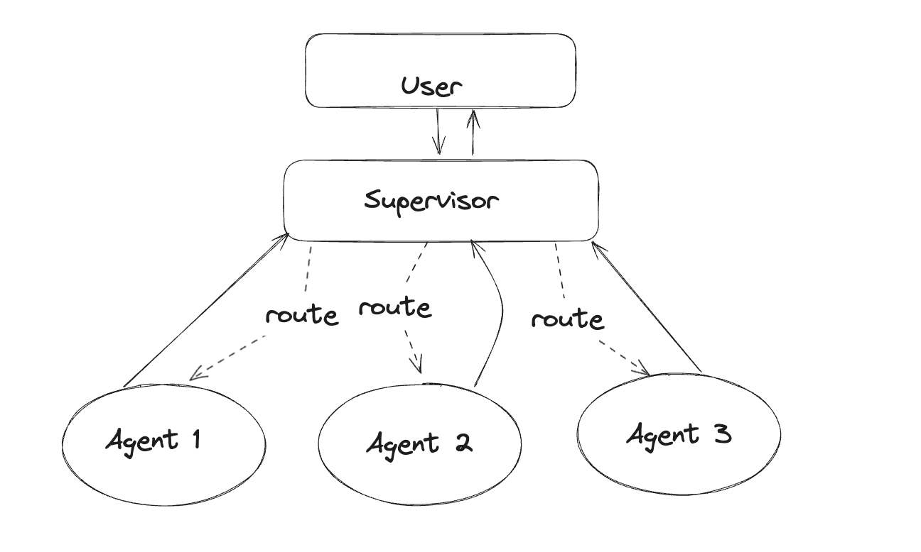
Basic LangGraph - User / Supervisor pattern

Slide 8
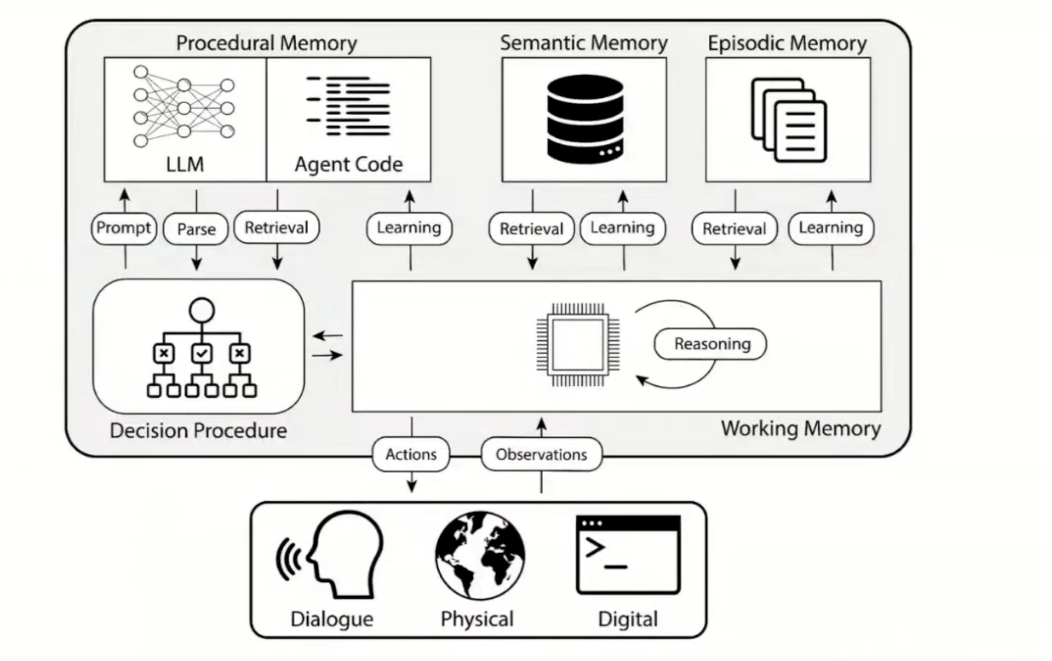
LangChain Agent Key Concepts
Agents
Independent Entity
Has access to tools
Reasons, Acts (ReAct)
Combination of
LLM
Code
Memory
Tools
Notes:
Prompts
Notes:
Break into a six slide deck. Put an easy visuals to describe

Slide 9
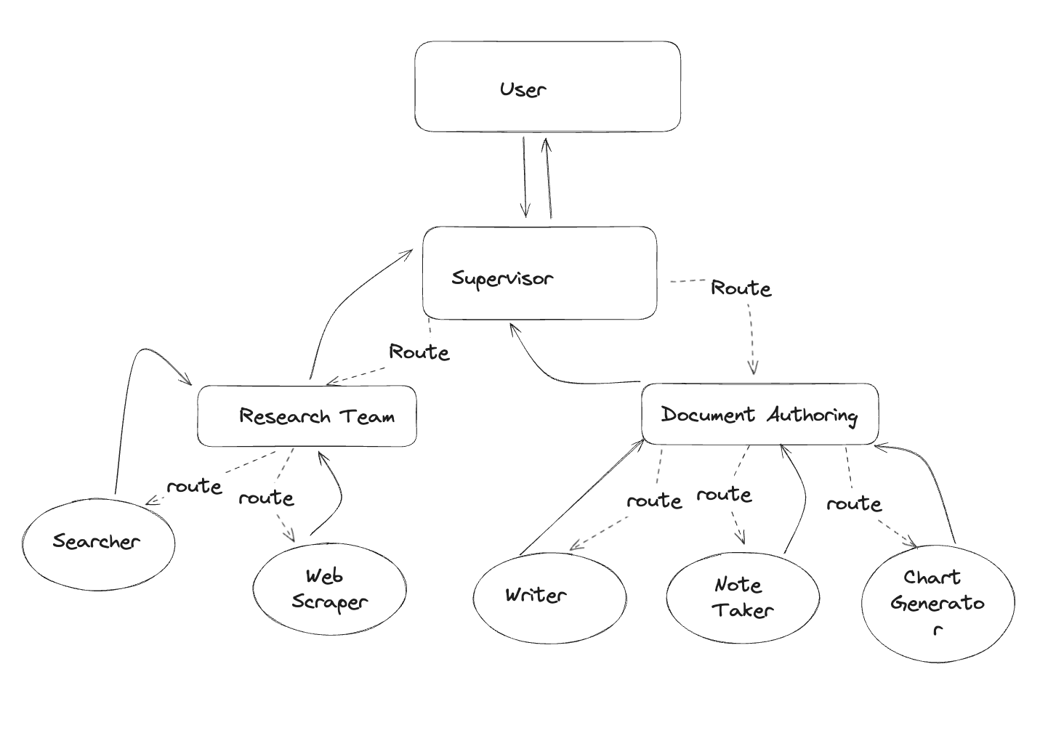
Hierarchical Teams

Slide 10
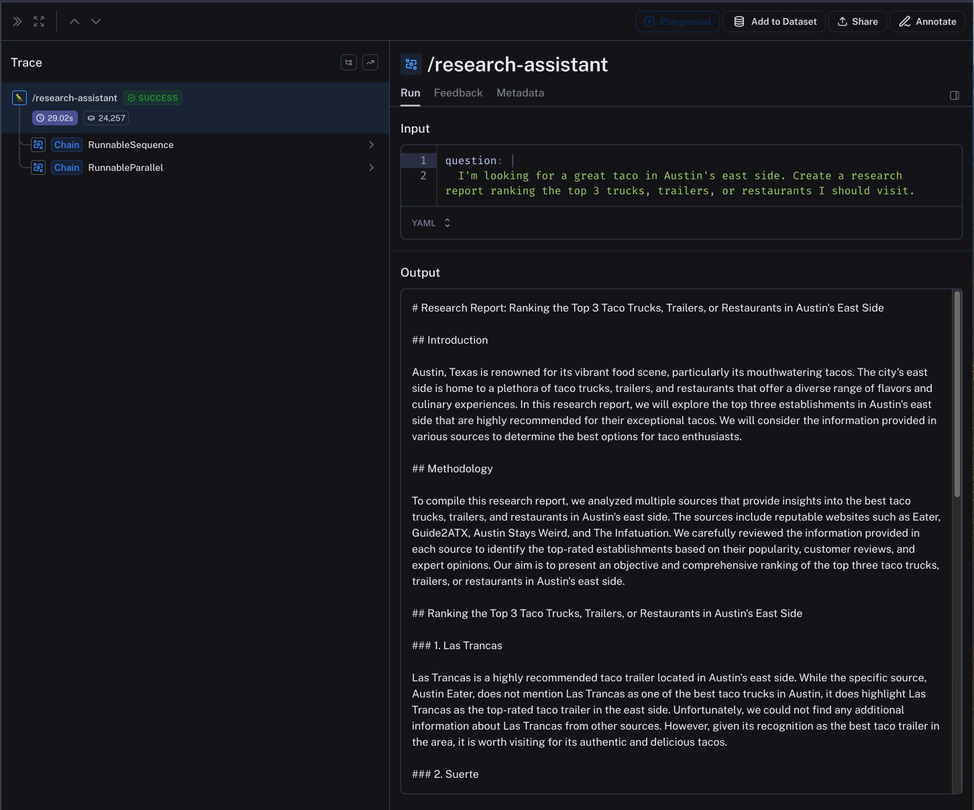
LangSmith
Web interface for logging of AI applications
Functional and Non-Functional information
Performance & Query optimization
Easily added to LangChain code
Deploy LangGraph Code

Slide 11
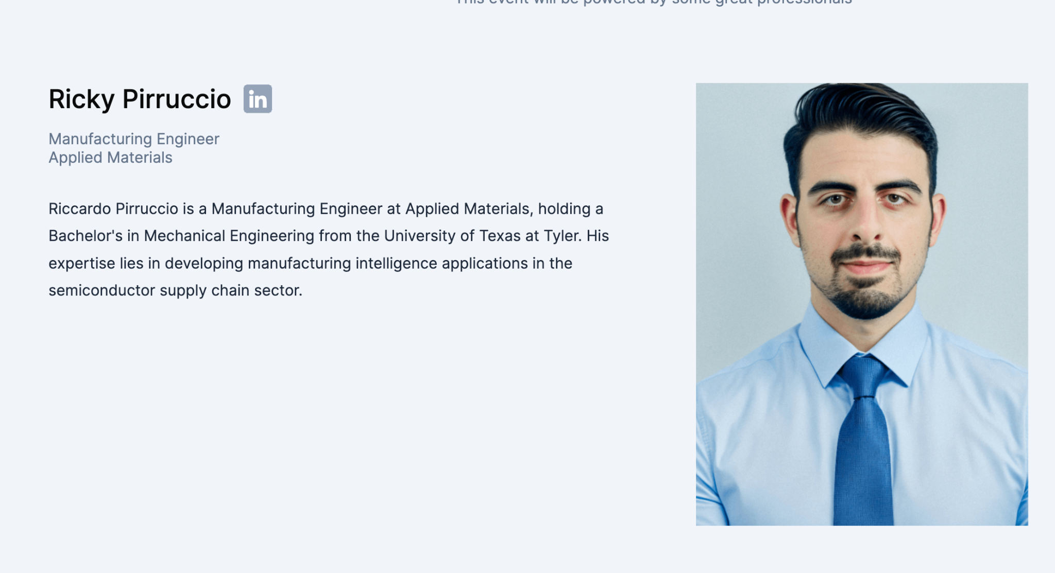
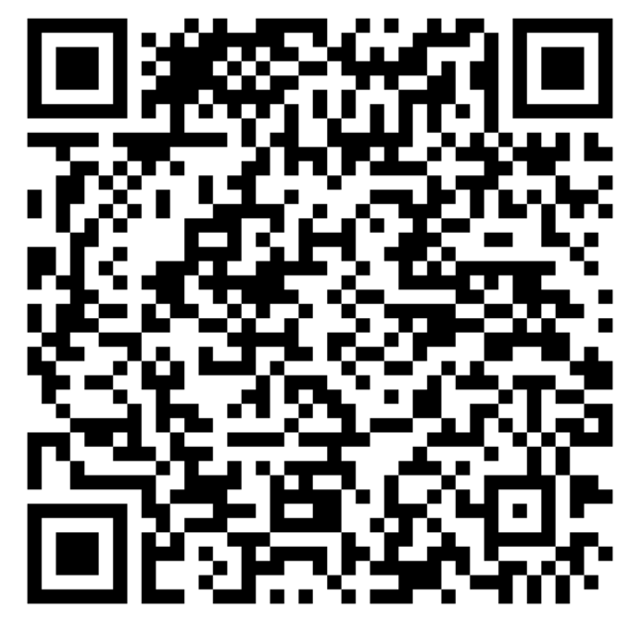
LangChain Quickstart

Slide 12
🦜🔗 July Meeting - NVIDIA Contest Showcases
Austin LangChain Users Group
Github
meet.aimug.org

Slide 13
Log into Sessions @ meet.aimug.org
Go here for Transcripts, Q&A, Links
https://meet.aimug.org/session/6cacd549-11e1-42c2-a3bc-01def0906ac2

Slide 14

Agenda
Welcome Message
News & Announcements
Talks and Labs!
Mixer Exercise
LangGraph Reporting
WebRTC - Voice enabled AI

Slide 15
Welcome - Austin LangChain
Local Austin LangChain User Group
Discord - https://discord.gg/fjQfpwcsZX
Github - https://github.com/colinmcnamara/austin_langchain
Meetup - https://www.meetup.com/austin-lanchain-ai-group/
Twitter - @AustinLangChain
Youtube - https://www.youtube.com/@AustinLangChain
Monthly in person meetings & workshops
Monthly virtual meetings
Low stress, learning and sharing
Connect with other early adopters
Learn, Share, Grow
CoC - Be cool to each other, no gross behavior
Notes:
Are you a AI / LLM enthusiast who finds the power of LangChain fascinating? Are you currently learning and utilizing this innovative technology? Look no further! Our meetup group is the perfect platform for you to connect with like-minded individuals in the Austin area who share your passion for LangChain.
Whether you're a beginner eager to dive into the world of LangChain or an experienced user looking to expand your knowledge, our group provides an inclusive and supportive environment for all levels of expertise. Join us to engage in enlightening discussions, share valuable insights, and collaborate on exciting projects related to LangChain.
Here's what you can expect from our meetup group:
Informative Presentations: We regularly host presentations by industry experts, researchers, and practitioners who will share their expertise and insights into the latest advancements in LangChain. These talks will cover various aspects, including best practices, practical applications, and future trends.
Hands-on Workshops: Get ready to roll up your sleeves and get your hands dirty! We organize interactive workshops that allow you to put your knowledge into practice. Learn how to leverage LangChain effectively through practical exercises, coding sessions, and collaborative problem-solving activities.
Networking Opportunities: Connect with fellow language enthusiasts, developers, researchers, and professionals who are passionate about LangChain. Expand your professional network, exchange ideas, and foster meaningful connections that can potentially lead to exciting collaborations or career opportunities.
Project Showcases: Share your LangChain projects and see what others have been working on. Our group provides a platform for members to showcase their creations, seek feedback, and receive support and encouragement from the community. This is a fantastic opportunity to gain inspiration, learn from others, and contribute to the growth of the LangChain ecosystem.
Q&A Sessions and Discussions: Have burning questions or specific topics you'd like to explore? Our meetups include interactive Q&A sessions and group discussions where you can seek clarifications, share your experiences, and engage in thought-provoking conversations about LangChain and its applications.
Join us today and become part of the vibrant Austin LangChain community! Let's learn, collaborate, and shape the future of language technology together. Whether you're a student, professional, researcher, or simply a curious individual, we welcome everyone with open arms. Together, we'll unlock the true potential of LangChain and revolutionize the way we interact with languages.
Note: This meetup group is conducted in English, and proficiency in LangChain is not a prerequisite for participation. We believe in creating an inclusive environment where everyone can learn and grow together.

Slide 16

Thanks to our Supporters
Lynx Ventures - Venue Sponsor
Jockomo Games - Food & Beverage
Always Cool Brands - Sessions Platform
Contributors - code, content, community

Slide 17

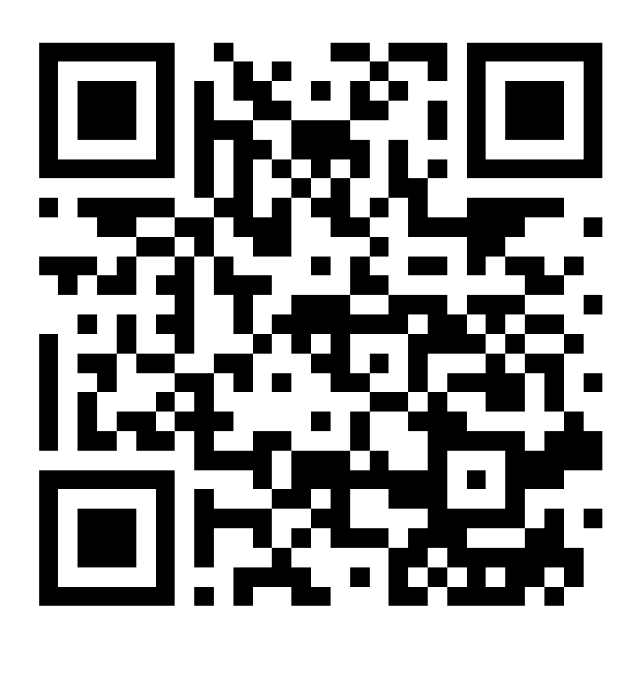

Slide 18

Interested in helping out?

Slide 19



News and Announcements
Hacky Hour - 6pm Wed April 17th @ Central Machine Works https://www.meetup.com/austin-langchain-ai-group/events/299873427/
Office Hours Tuesdays at 2pm on Discord - https://discord.gg/fjQfpwcsZX
Community call Thursdays at 2:30 - https://app.sessions.us/session/56b791ec-0676-45ee-9caf-cfd72b3faa32
Video Posted Exploring LangGraph - https://www.youtube.com/watch?v=c-7xpl7ahZw&t=106s
Blazer Tag w/ KJES4 Sunday April 7th @ 12 Noon

Slide 20
Austin Lang Chain Events
Office Hours Tuesdays at 2pm on Discord - https://discord.gg/fjQfpwcsZX
Community Call Thursdays at 2:00 - https://app.sessions.us/session/56b791ec-0676-45ee-9caf-cfd72b3faa32
Hacky Hour - 6pm Wed July 24th @ Luster Pearl East https://www.meetup.com/austin-langchain-ai-group/events/302162630/?slug=austin-langchain-ai-group&eventId=301087611
Showcases - In person and hybrid August 7 @ DTAC

Slide 21
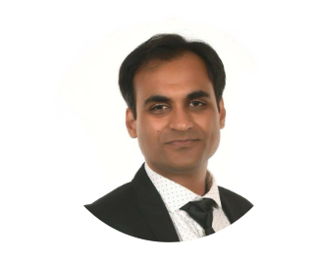
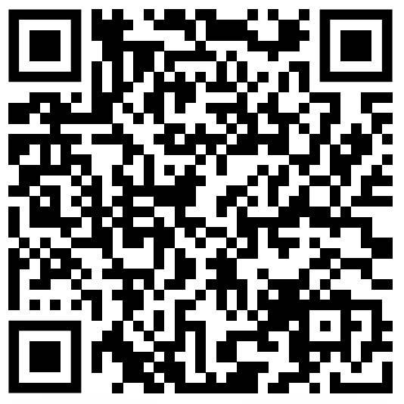
Style Guide - AI Fashion Assistant

Slide 22
Style Guide - AI Fashion Assistant
NVIDIA + LangChain Generative AI Contest entry by Karim Lalani
Presented at Austin LangChain Meetup on July 10th 2024

Slide 23
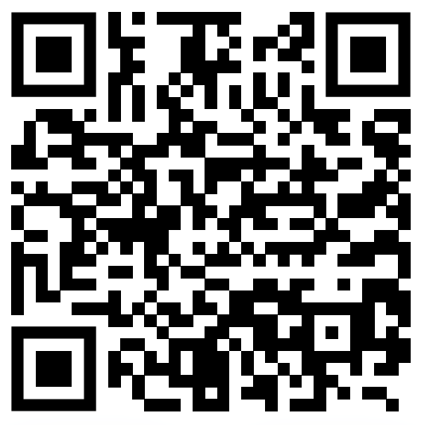
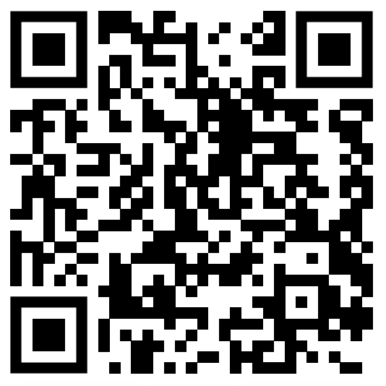
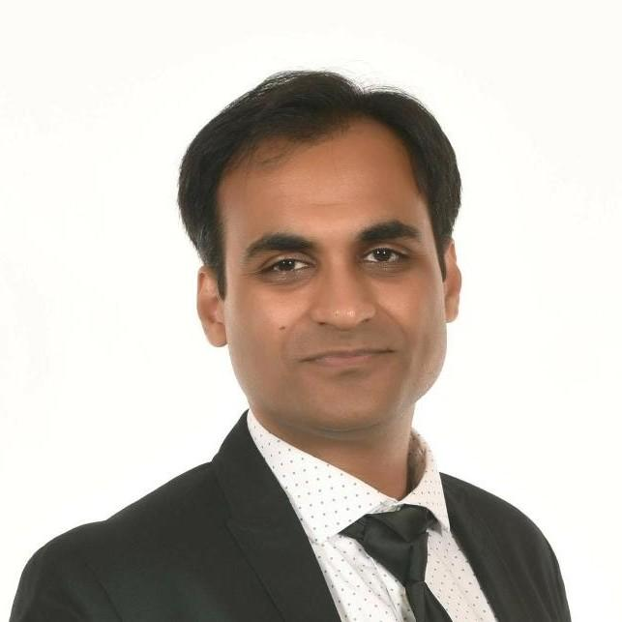
Socials
LinkedIn @-karim-lalani/ | Github @lalanikarim | Medium @klcoder

Slide 24
Project Overview
Voice enabled AI assistant
Lets you talk to your wardrobe
Analyzes uploaded photos
Identifies the kind of clothes, color, style, etc.
Stores attributes along with photo in a vector database
Suggests outfits based on user’s query
Show me casual wear
Show me formal wear
Show me blue shirts
I am going on a vacation to the Mediterranean. Suggest some outfits to pack.

Slide 25
Technologies
Speech to text is using OpenAI's open source Whisper mini model.
Text to Audio is using Suno's open source Bark small model.
WebRTC scaffolding from WebRTC AI Voice Chat project.
Hosted AI Inference NVIDIA Inference Microservice (NIM):
Text-to-text LLM meta/llama3-8b-instruct
Image-to-text VLLM microsoft/phi-3-vision-128k-instruct
Retrieval Embeddings nvidia/embed-qa-4
Document and Vector store database SurrealDB
Web Search using DuckDuckGo
GenAI framework LangChain
GenAI API calls monitoring and tracing LangSmith from LangChain

Slide 26
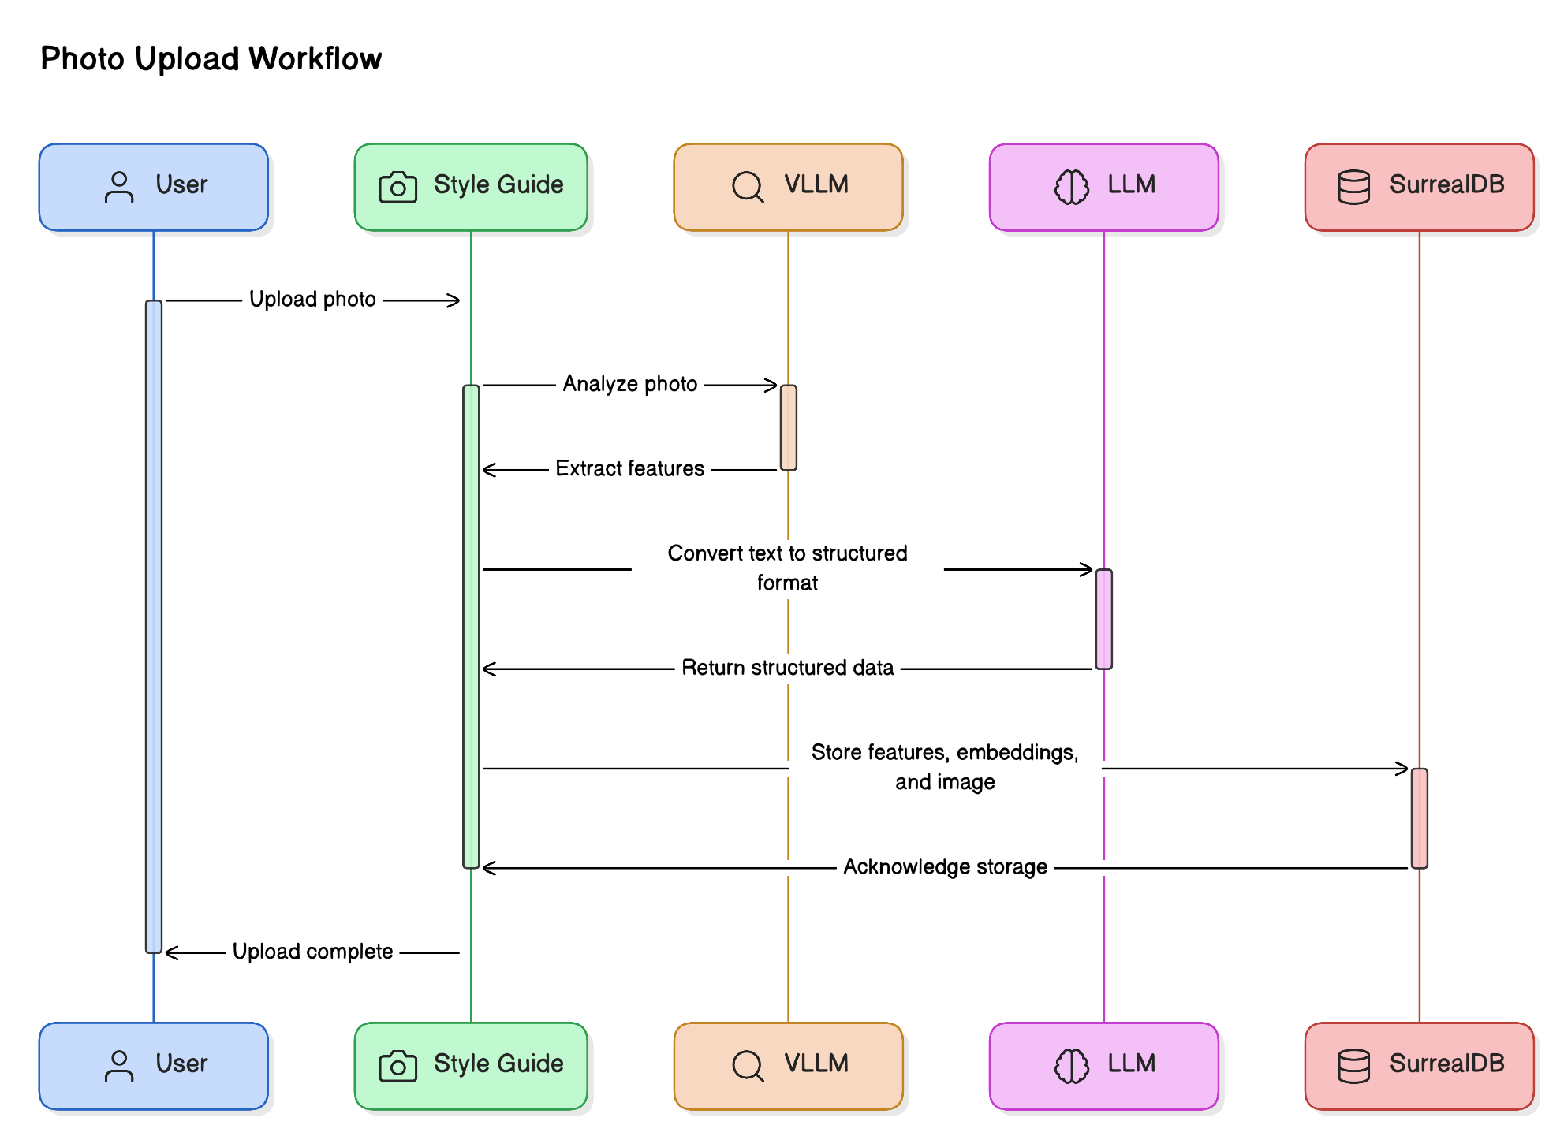
Photo upload workflow

Slide 27
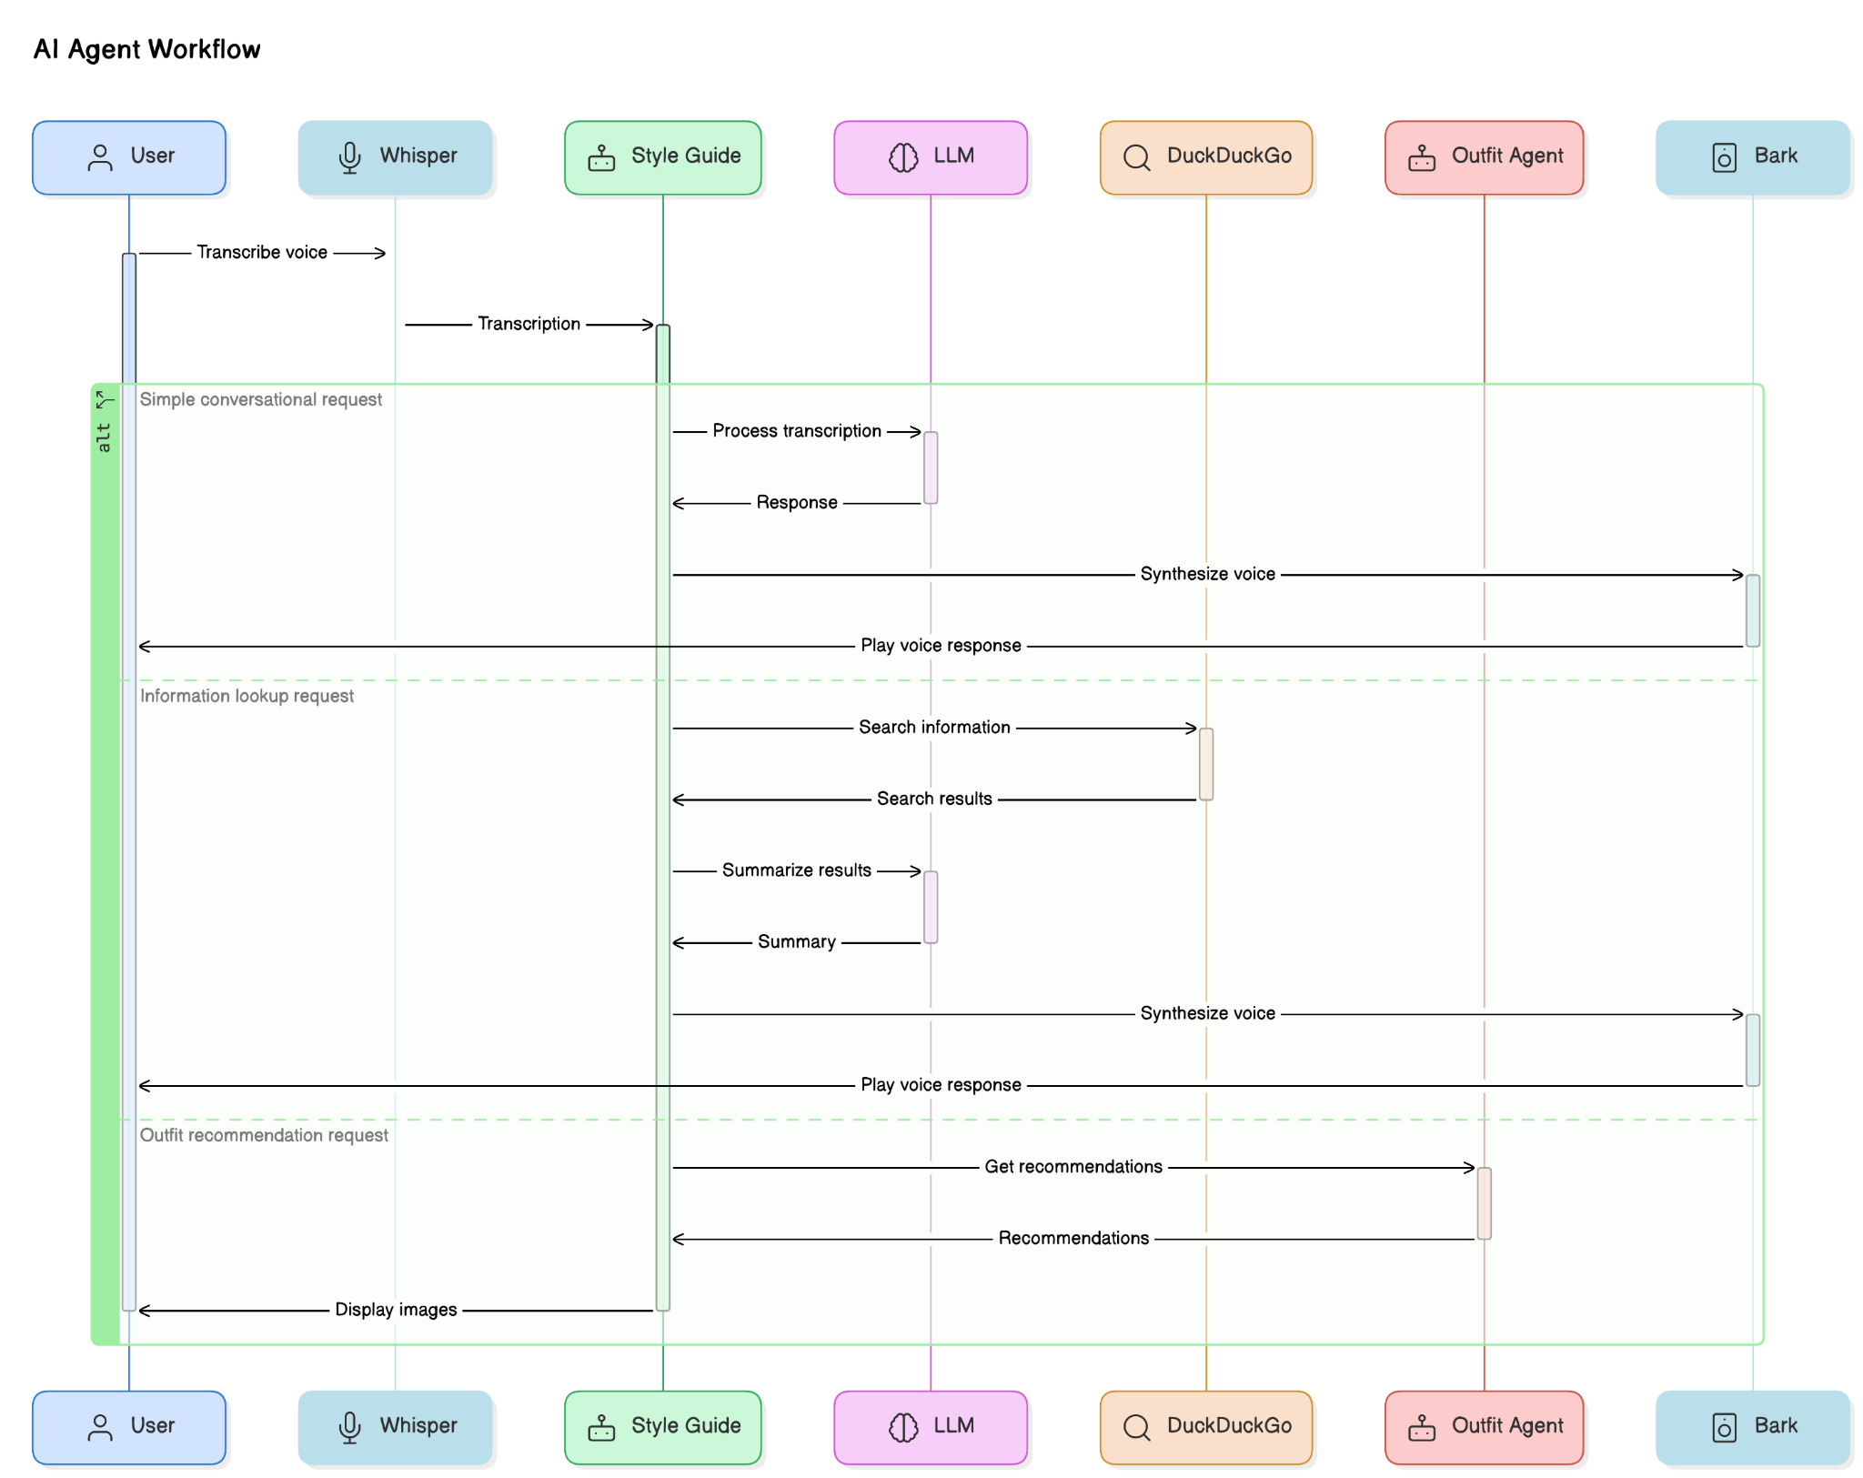
AI Agent
Workflow

Slide 28
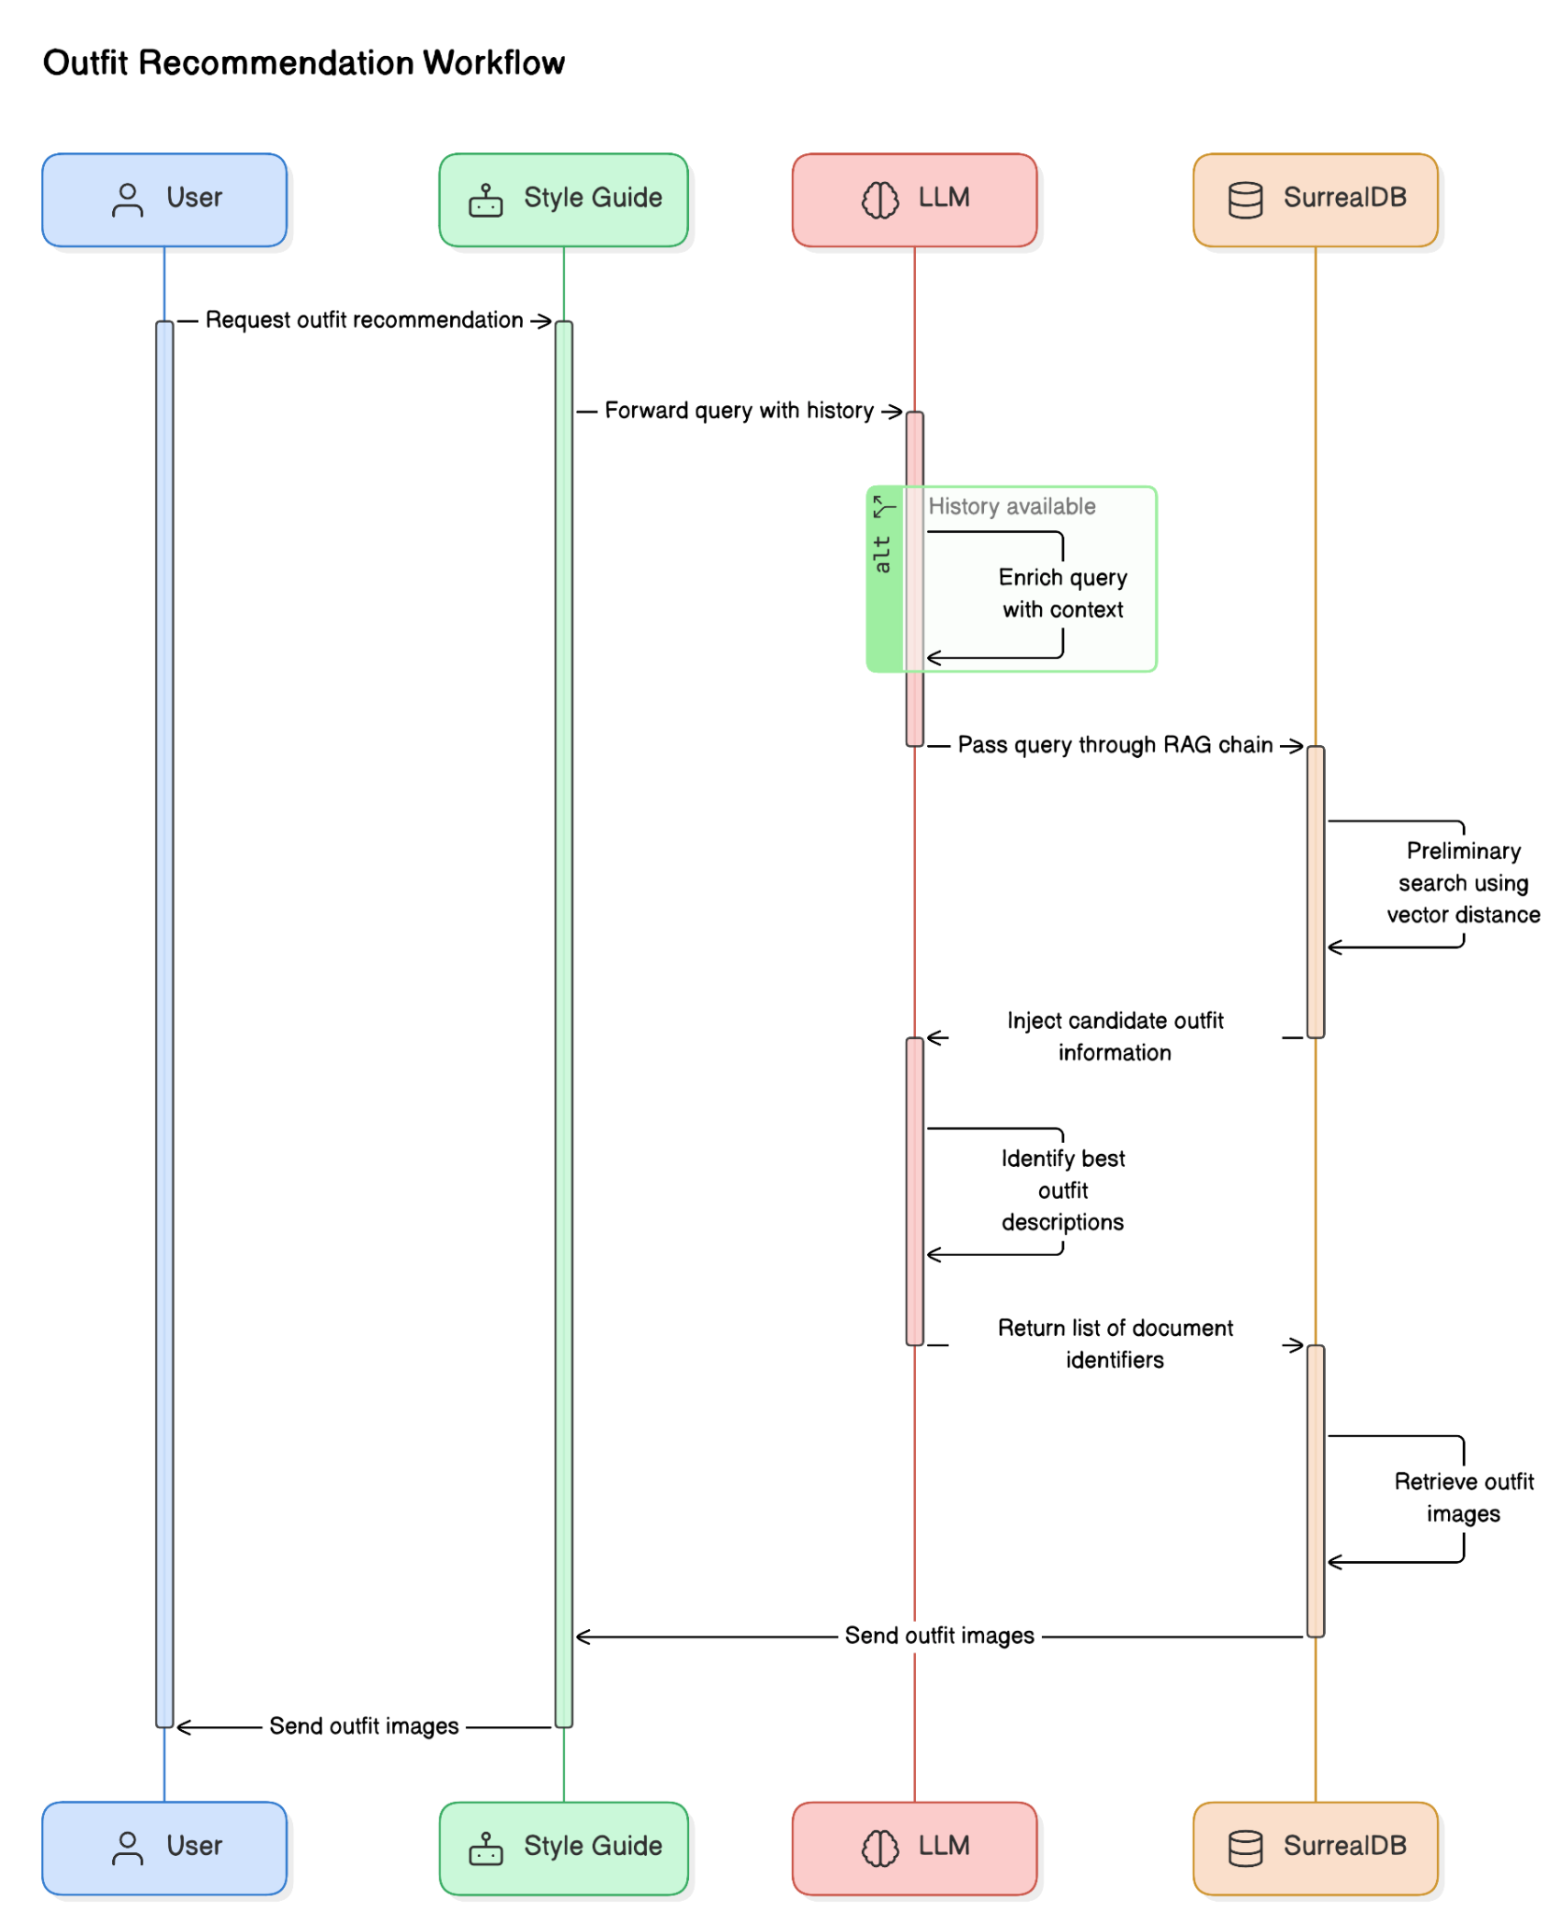
Outfit Recommendation
Workflow

Slide 29
Challenge - ChatNVIDIA lacks tool calling support
ChatNVIDIA model within langchain-nvidia-ai-endpoints package didn’t support tool calling at the time of contest
Resolution
Wrote a wrapper inspired by OllamaFunctions to add tool calling capabilities to ChatNVIDIA model
nvidia_functions = create_tool_calling_model(ChatNVIDIA, "chat_nvidia_functions")
https://github.com/lalanikarim/style-guide-ai-assistant/blob/main/tool_calling_model.py
PR #23193 has been submitted to LangChain with a Python mixin version of the wrapper

Slide 30
Challenge - phi-3-vision’s poor JSON output quality
phi-3-vision-128k-instruct model didn’t generate json output which was needed to extract features as structured output
Resolution
Deferred structured output parsing to llama3-8b-instruct which handled tool calling and structured output parsing reliably
outfit_output_llm = _llm.with_structured_output(Outfit, include_raw=False) nv_fc_chain = RunnableLambda(get_image_prompt) | _vllm | RunnableLambda(get_message_content) | outfit_output_llm

Slide 31
Demo

Slide 32
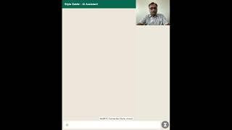

Slide 33
Questions?

Slide 34
Resources
Github - https://github.com/lalanikarim/style-guide-ai-assistant/
NVIDIA NIM Playground - https://build.nvidia.com/explore/discover
Surreal DB - https://surrealdb.com/
LangChain - https://www.langchain.com/
Most Awesome LangChain Resource in Central TX - https://www.meetup.com/austin-langchain-ai-group/

Slide 35
Thank you!

Slide 36

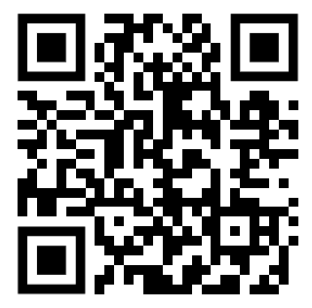
Jackson Arnold - Next.js + LangServe
LangServe repo: https://github.com/jacksonarnold/assistant-langserve-api/tree/main
Next.js repo: https://github.com/jacksonarnold/summarizer-app
Deck:https://docs.google.com/presentation/d/10SIfXZiJGn8CIkK5vZGVN7n7bZKCnE6G052RONq4hNQ/edit?usp=sharing
LinkedIn: https://www.linkedin.com/in/jackson-s-arnold/

Slide 37
Next.js + LangServe

Slide 38
Purpose
Original purpose of the app
Create a template for full-stack, LangChain integrated web app
Project for learning and sharing through the process
Notes:
Purpose of the app - use case and back story
Dad’s interest in tech, AI, and followed frustration
My interest in AI and how to integrate it within products
Specific use case for legal documents (non-competes)
Create a template for full-stack, LangChain integrated web app
Current use case presented opportunity to learn
Create a reusable template for other projects or ideas
Have a project for learning and sharing
Wanted to share, get feedback, and offer the opportunity to jump in and learn with me

Slide 39
Current Stack
Next.js 14 - using TypeScript
NextUI
NextAuth.js
v0.dev for inspiration
FastAPI with LangServe
MongoDB
Notes:
Next.js 14
Have a component library integrated into the application
NextAuth.js - have auth working for sign in… but we’ll get back to this
V0.dev - used for mock up ideas a components
FastAPI w/ LangServe
Have a server using LangServe
LangServe built on FastAPI
MongoDB
Deployed to cloud on MongoDB Atlas

Slide 40
Where we’re at
Next.js
Component library installed - basic UI and navigation layout
Authentication - sign in & sign out
Upload documents and generating summary through invoke or stream

Slide 41
What’s Next
Move MongoDB calls to backend
Swap NextAuth.js for FireBase Auth
Strip any PII from uploaded documents
Deploy Next.js app to Vercel
Integration with LangGraph

Slide 42
Show and Tell

Slide 43
Repository links
LangServe - https://github.com/jacksonarnold/assistant-langserve-api/tree/main
Next.js - https://github.com/jacksonarnold/summarizer-app

Slide 44
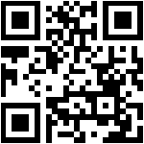
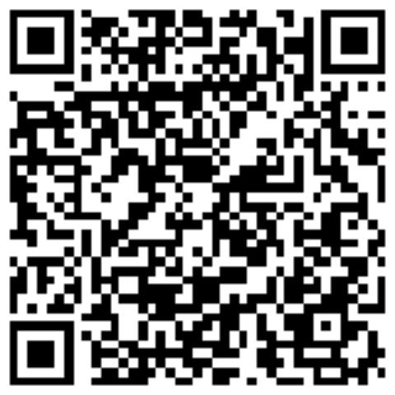
Connect With Me
GitHub
LinkedIn
Email: jacksonarnold96@gmail.com

Slide 45
Thank you - See you next time - Hacky Hour 7/24
Local Austin LangChain User Group
Discord - https://discord.gg/fjQfpwcsZX
Github - https://github.com/colinmcnamara/austin_langchain
Meetup - https://www.meetup.com/austin-lanchain-ai-group/
Twitter - @AustinLangChain
Youtube - https://www.youtube.com/@AustinLangChain
Monthly in person meetings & workshops
Monthly Hacky Hours
Tuesdays & Thursdays @ 2 CDT Office Hours
Notes:
Are you a AI / LLM enthusiast who finds the power of LangChain fascinating? Are you currently learning and utilizing this innovative technology? Look no further! Our meetup group is the perfect platform for you to connect with like-minded individuals in the Austin area who share your passion for LangChain.
Whether you're a beginner eager to dive into the world of LangChain or an experienced user looking to expand your knowledge, our group provides an inclusive and supportive environment for all levels of expertise. Join us to engage in enlightening discussions, share valuable insights, and collaborate on exciting projects related to LangChain.
Here's what you can expect from our meetup group:
Informative Presentations: We regularly host presentations by industry experts, researchers, and practitioners who will share their expertise and insights into the latest advancements in LangChain. These talks will cover various aspects, including best practices, practical applications, and future trends.
Hands-on Workshops: Get ready to roll up your sleeves and get your hands dirty! We organize interactive workshops that allow you to put your knowledge into practice. Learn how to leverage LangChain effectively through practical exercises, coding sessions, and collaborative problem-solving activities.
Networking Opportunities: Connect with fellow language enthusiasts, developers, researchers, and professionals who are passionate about LangChain. Expand your professional network, exchange ideas, and foster meaningful connections that can potentially lead to exciting collaborations or career opportunities.
Project Showcases: Share your LangChain projects and see what others have been working on. Our group provides a platform for members to showcase their creations, seek feedback, and receive support and encouragement from the community. This is a fantastic opportunity to gain inspiration, learn from others, and contribute to the growth of the LangChain ecosystem.
Q&A Sessions and Discussions: Have burning questions or specific topics you'd like to explore? Our meetups include interactive Q&A sessions and group discussions where you can seek clarifications, share your experiences, and engage in thought-provoking conversations about LangChain and its applications.
Join us today and become part of the vibrant Austin LangChain community! Let's learn, collaborate, and shape the future of language technology together. Whether you're a student, professional, researcher, or simply a curious individual, we welcome everyone with open arms. Together, we'll unlock the true potential of LangChain and revolutionize the way we interact with languages.
Note: This meetup group is conducted in English, and proficiency in LangChain is not a prerequisite for participation. We believe in creating an inclusive environment where everyone can learn and grow together.

